Slide 1
SEXUAL REPRODUCTION IN FLOWERING PLANTS
CHAPTER -02,CLASS-XII,BIOLOGY

Slide 2
Flower- A modified shoot
Reproductive structure of angiosperms

Slide 3
*FLORICULTURE : the cultivation of
flowering plants.
*Several hormonal and structural changes are initiated which lead to the differentiation and development of the floral PRIMORDIUM
*Primordium- an organ in its earliest stage of development; the foundation for subsequent development
*Inflorescences are formed which bear the floral buds and then the flowers.
*In the flower the male and female reproductive structures, the androecium (MALE) and the gynoecium ( FEMALE ) differentiate and develop.
*
3

Slide 4
A typical stamen-
The long and slender stalk called the filament
The terminal bilobed structure called the anther.
Monothecous-Hibiscus, Dithecous -brinjal
The proximal end of the filament is attached to the thalamus or the petal of the flower. Check terminology.
The number and length of stamens vary.
*
4

Slide 5
Dithecous - Anther is bilobed
with each lobe having two theca
A longitudinal groove runs
lengthwise separating the theca.

Slide 7
T.S. OF AN ANTHER

Slide 8
*The anther is a four-sided (tetragonal) structure - four
microsporangia located at the corners, two in each lobe.
*The microsporangia develop- pollen sacs. They extend longitudinally ,are packed with pollen grains.
*Structure of microsporangium: In T.S. a typical microsporangium appears circular in outline. It is generally surrounded by four wall layers -- the epidermis, endothecium, middle layers and the tapetum.
*The outer three wall layers perform the function of protection and help in dehiscence of anther to release the pollen.
* The innermost wall layer is the tapetum. It nourishes the developing pollen grains. Cells of the tapetum possess dense cytoplasm and generally have more than one nucleus. Nucleus divides – without cytoplasmic division- polyploidy

Slide 9
*When the anther is young, a group of compactly arranged homogenous cells -the sporogenous tissue occupies the centre of each microsporangium.
*The cells of the sporogenous tissue undergo meiotic divisions
to form microspore tetrads. ( haploidy)
*
9

Slide 10
Potential pollen / Potential microspore mother cell
Micro- spore Tetrad
Pollen
grains
Cells
of sporangeous tissue
Anthers
mature,
Meiosis
Four cells Haploid
Tetrad cells separates
Micro-
sporogenesis
Stay together ^{Dehydration}
Dissociate
*

Slide 11
*Pollen grain wall- exine and intine.
*Exine – thick hard ornamental, made up of sporopollenin
( most resistant organic material high temperature, acid, alkalies)
*Germ pore- circular aperture in exine- spropollenin absent.
Pollen tube emerges from germ pore
*The inner wall of the pollen grain intine- a thin and continuous
layer made up of cellulose and p₁e₂ctin.

Slide 13
* The pollen grains represent the male gametophytes.
* Sizes, shapes, colours, designs- different species
* Fossils because of the presence of sporopollenin
* Cryopreservation(-196 ⁰C ) used in crop breeding
* Pollen food nutritional value –
performance of athletes and race horses
* Pollen Allergy, bronchial
* Afflictions, asthma, bronchitis eg
Parthenium
* Viability of pollen grains depends on temperature and humidity. Viable from few mins to several months few mins (rice) to few months (Solanacae), Rosaceae, Leguminoseae
*
-

Slide 14
The cytoplasm of pollen grain is surrounded by a plasma membrane. A mature pollen grain – ( inside intine and exine )
During development from microspore mitosis – 2 cells
Vegetative cell / Tube cell --bigger, has abundant -food reserve and a large irregularly shaped nucleus.
Generative Cell -- small , spindle shaped with dense cytoplasm & a nucleus. It floats in the cytoplasm of the vegetative cell.
60 % angiosperms, pollen grains are shed at 2-celled stage.
In others generative cell divides mitotically - the two male gametes before pollen grains are shed (3-celled stage).

Slide 15
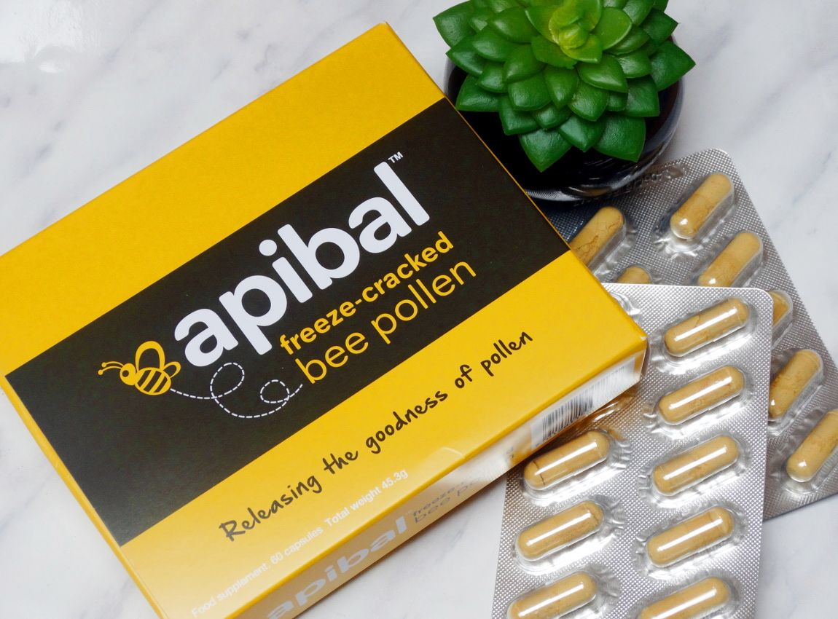

Slide 16
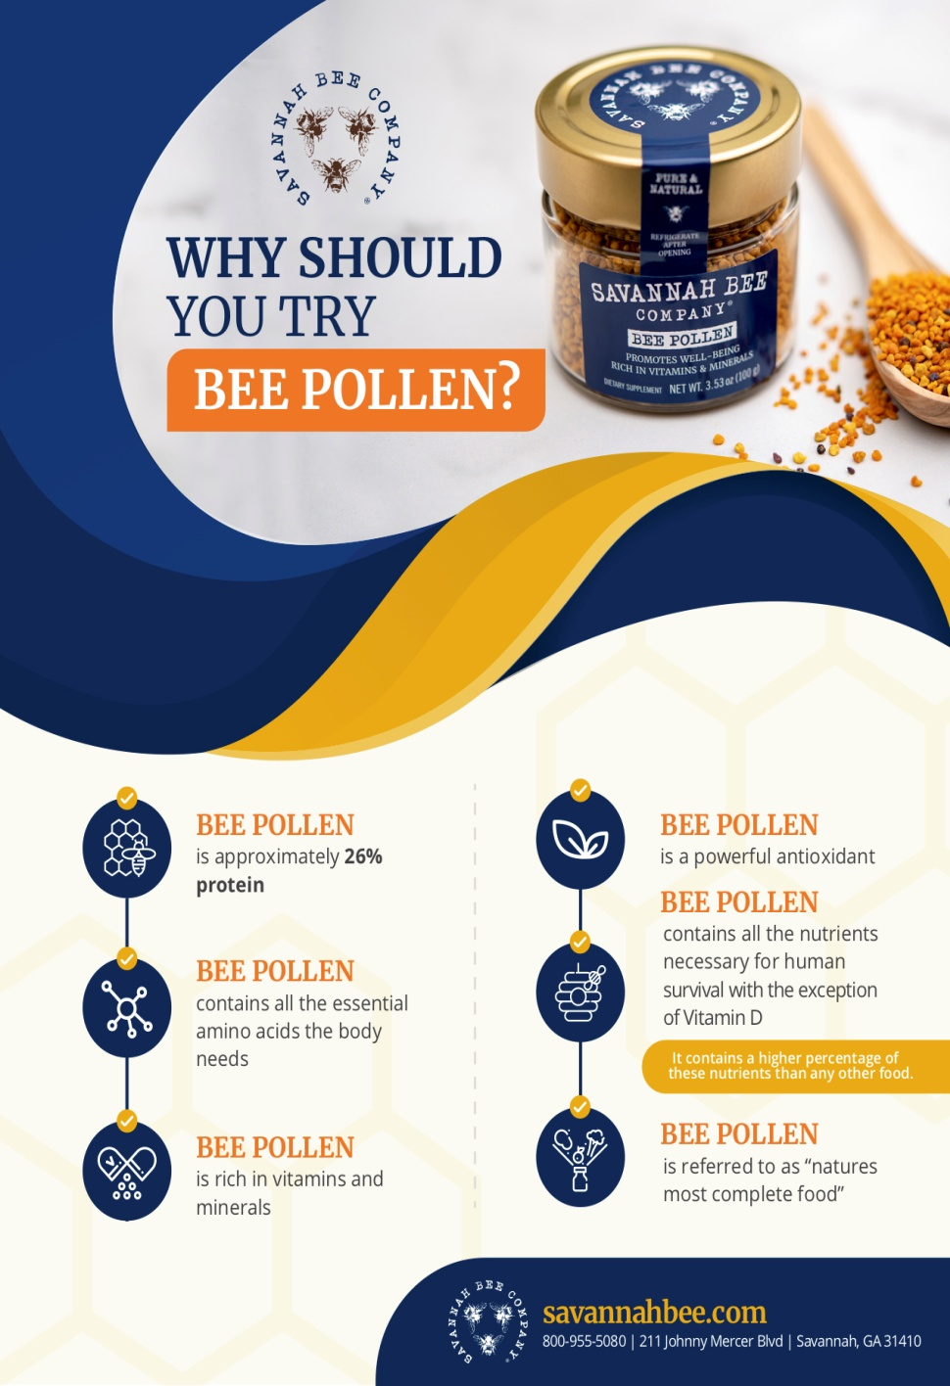

Slide 18
*Pistil/gynoecium innermost whorl of a flower.
*Carpel – stigma , style , Ovary
*Ovary many ovule ( megasporangia) attached to a tissue inside ovary – placenta – ovarian cavity ( locules) –
*Placentation – Arrangement of ovules in a ovary.
*Number of ovules in an ovary may be one (wheat,
paddy, mango) to many (papaya, water melon, orchids).
Monocarpellary / multicarpellary
*Syncarpous ( pistils fused together) , aopcarpous (free)
*
15

Slide 19
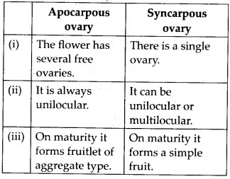
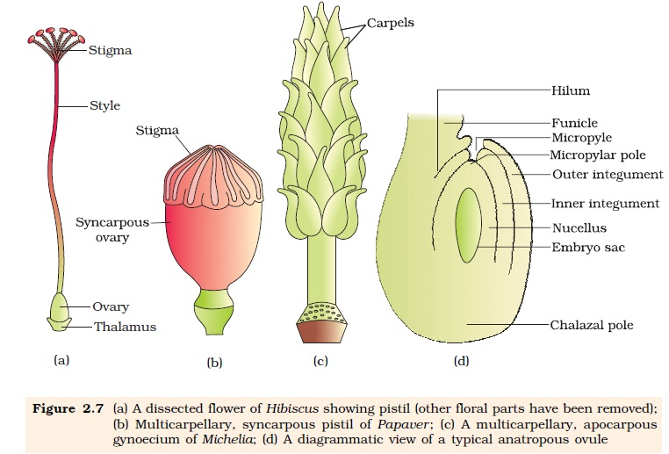

Slide 20
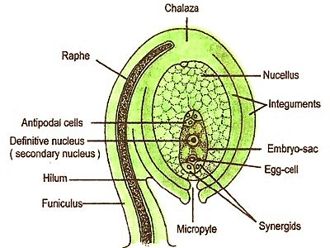

Slide 21
1. | Funicle | The ovule is attached to the placenta by means of a stalk called funicle.
2. | Hilum | The body of the ovule fuses with funicle in the region called hilum.(hilum - the junction between ovule and funicle)
3. | Integuments | Each ovule has one or two protective envelopes called integuments.(inner and outer )
4. | Micropyle | The integuments leave small opening at one end called micropyle.- this end is micropylar end.
5. | Chalaza | Opposite the micropylar end, is the chalaza, representing the basal part of the ovule.
6. | Nucellus | Tissue encloses embryo sac
7. | Embryo sac (female gametophyte) | An ovule generally has a single embryo sac formed from a megaspore through reduction division. 8 Nucleate and 7 celled. Egg apparatus- at micropylar end. It has 2 synergids and an egg. Fili form apparatus- synegids – special thickening at micropylar end. It guides the pollen tube. Antipodals- 3 in number twds chalazal end. Two Haploid nuclei at polar end below egg appataus
*
18

Slide 22
Megaspore mother cells MMC
Deploid
Megaspore haploid Monosporic development
Functional megasopre to Embryo sac
Cells in the nucellus near micropylar region.
Meiosis
Four cells Haploid
3 near micropyle
Functional megaspore enlarges, mitotic division 2 nuclei – move opposite poles – 2 mitoic division- 4 nuclei at each pole Wall formation only after this stage
Chalaza end – 3 form antipodals Micropylar end – 3 form egg apparatus
Mega- sporogenesis
degenerrate 1 functional megaspore
Remaining 2 nucei Polar nuclei in large central cell.
*

Slide 23
Megaspore mother cells MMC
Diploid
*

Slide 24
Functional megaspore enlarges, mitotic division 2 nuclei – move opposite poles – 2 mitoic division- 4 nuclei at each pole
Wall formation only after this stage Chalaza end – 3 form antipodals Micropylar end – 3 form egg apparatus
Functional megasopre to Embryo sac
Remaining 2 Polar nuclei in large central cell.

Slide 25
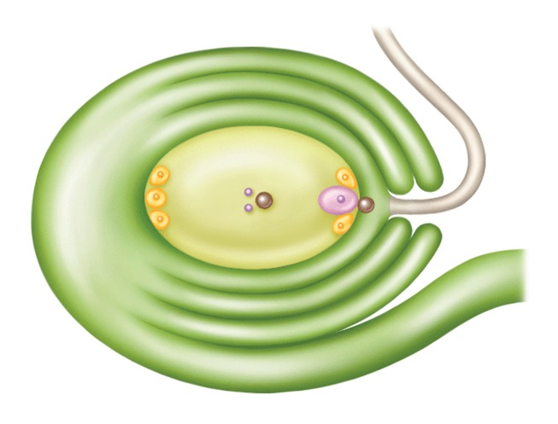
*

Slide 27
Pollination:
Transfer of pollen grains from the anther to the stigma of a pistil is termed as pollination.
Both male and female gametes are non-motile.
Kinds of pollination:
1.Self and
2.Cross Pollination
SELF POLLINATION
Autogamy:
Pollination within same flower.
In open and exposed anthers and stigma autogamy is rare.
Viola, Oxalis and Commelina produce two types of flowers:
Chasmogamous: exposed anther and stigma
Cleistogamous: closed anther and stigma.
Cleistogamous flower is invariably autogamous and assured seed set even in the absence of the pollinator.

Slide 28
Geitonogamy:
Pollination between two flowers of the same plant.
Pollination by pollinating agent.
Genetically similar to the autogamy.
CROSS POLLINATION
Xenogamy:
Transfer of pollen grains from the anther to the stigma of different plant.
It is commonly called as cross-pollination.
It brings genetically different types of pollen grains to the stigma

Slide 29
Agents of pollination:
Plant use two abiotic agent i.e. wind and water for pollination.
One biotic agent for pollination such as animals.
Majority of plant use biotic agent for pollination.
Few plant use abiotic pollinating agent.

Slide 30
ANEMOPHILY:
Pollinating agent is wind.
Plants produces enormous amount of pollen when compared to the number of ovules available for pollination to compensate the uncertainties of pollination.
Flowers with well exposed stamens.
Large feathery stigma to trap air-borne pollen grains.
Most wind pollinated flower contains single ovule in one ovary and numerous flower packed into an inflorescence e.g. corn cob.
Pollen grains are light and non-sticky.

Slide 31
HYDROPHILIC:
Pollination by abiotic agent like water.
This type of pollination is very rare, about 30 genera,
 mostly monocot.
Vallisneria, Hydrilla and Zostera are the common example for Hydrophily.
All aquatic plants are not Hydrophily.
Pollen grains released into the surface of water and carried to the stigma by air current as in Vallisneria.
In sea grass the flowers remained submerged.
Pollen grains are long, ribbon like and carried passively inside the water
Pollen grains are protected from wetting
 by mucilaginous covering.

Slide 32
POLLINATION
SELF
Same flower /different flower of same species
AUTOGAMY
Flowers open ,Synchrony in pollen release and stigma close arrangement.
GENITOGAMY
Different flower of same plant.
CROSS
Two flower of different plants of same species
XENOGAMY
Different flower of different plant.
CHASMOGAMY
Open flower
CLEISTOGAMOY
Do not open at all

Slide 33
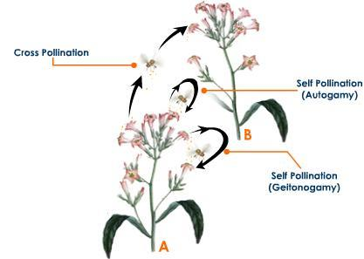

Slide 34
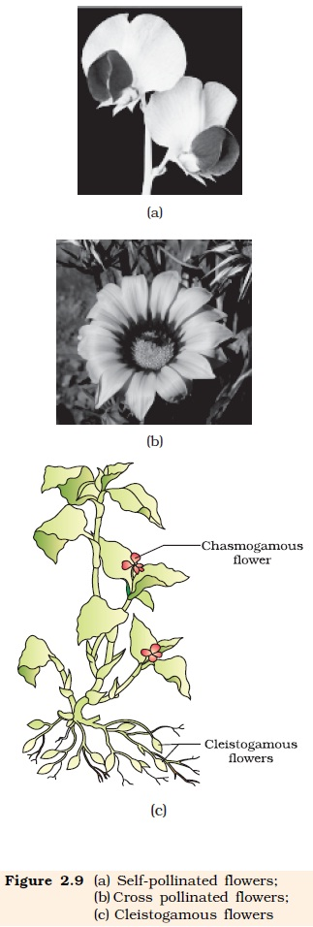

Slide 35
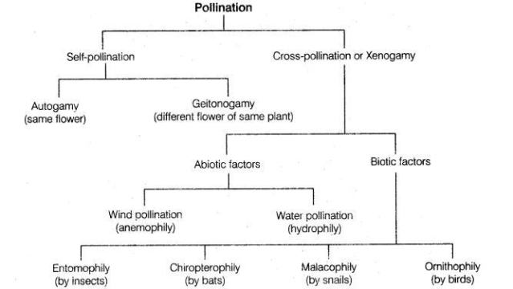

Slide 36
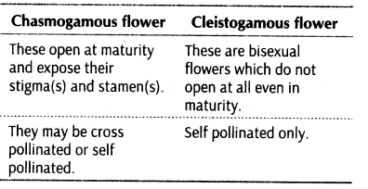

Slide 38
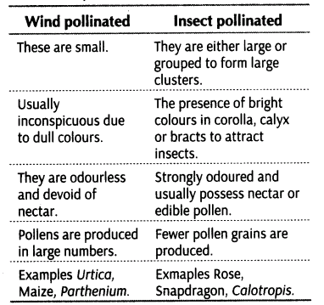

Slide 39
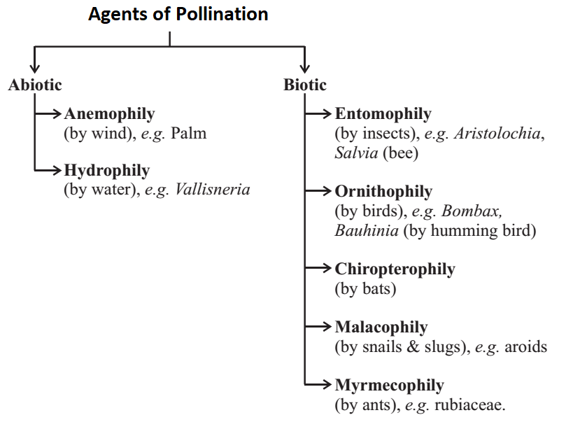

Slide 40
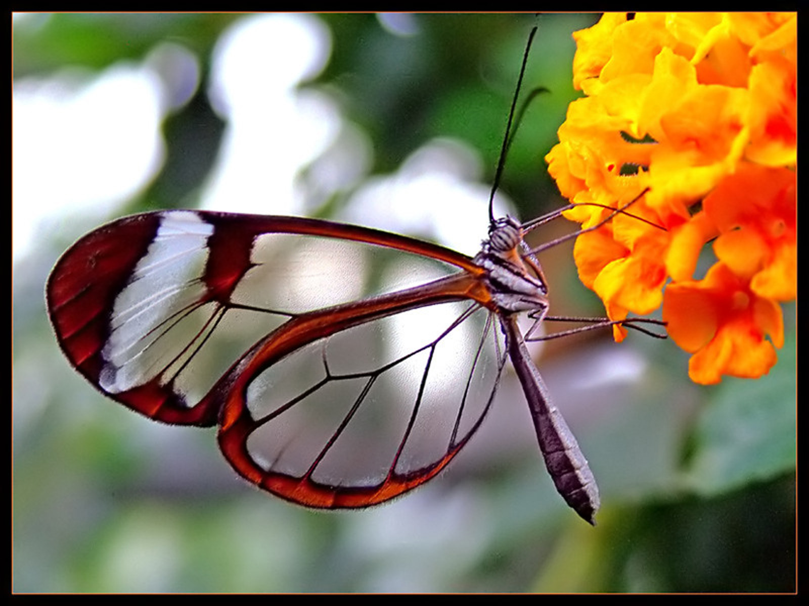

Slide 41
*All events from deposition of pollen grains on stigma – entry of pollen tube into the ovule -Pollen pistil interaction
*Identification of compatible (same species) or incompatible(
other species) pollen grains by stigma
*A dynamic process involving pollen recognition followed by promotion or inhibition of the pollen.
*Reason – chemical interaction between pollen and stigma
*Compatible pollen accepted by stigma, initiates post pollination events
*

Slide 43
OUT BREEDING DEVICES
Out breeding devices are mechanisms which are followed and adapted by the plants in order to prevent self pollination. The examples of out breeding devices are:
Unisexuality: The plant may be unisexual, which means it may exhibit either male or female gametes.
Dichogamy: In this mechanism the male reproductive part the anther and the female reproductive part the stigma matures at different times, therefore avoids self pollination.
Self sterility: The gene in the female reproductive part of the flower which recognizes the gene present in the pollen grain of the same plant, prevents the fertilization results in self sterility.
Herkogamy: The natural barriers prevents the pollen of the same flower to pollinate the ovary of the same flower.
Hetrostyly: The anther and stigma are present at different levels of the flower which prevents the self pollination and fertilization.
Pollen prepotency: The pollen of the different flower germinate faster than the pollen of the same flower thus preventing self pollination.

Slide 44
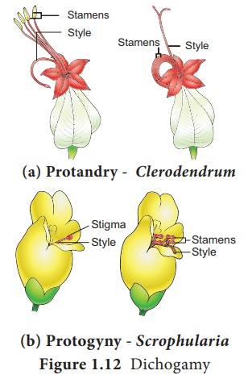

Slide 45
In bisexual flowers, pollen grains are likely to come in contact with stigma of the same flower. Continued self-pollination results in in- breeding depression.
Flowering plants have evolved devices to discourage self-pollination and to encourage cross- pollination, such devices are called out- breeding devices.
Strategy 1: Anther and stigma are placed at different positions so that pollens cannot come in contact with stigma of the same flower.
Strategy 2: Production of unisexual flowers.
Strategy 3: In some species, anther release and stigma receptivity are not synchronized.
Strategy 4: Self-incompatibility is a genetic mechanism which prevents self-pollen from fertilizing the ovule by inhibiting pollen germination on stigma.

Slide 46
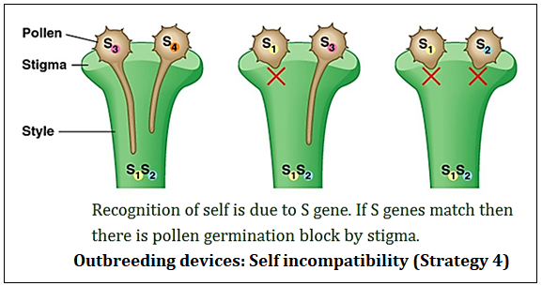

Slide 47
*Germination of Pollen
*Germination- formation of pollen tube through germ pore- content move to pollen tube- through stigma, style reaches ovary
*Pollen grains - two-celled condition (a vegetative cell and a generate cell)- the generative cell divides and forms the two male gametes during the growth of pollen tube in the stigma.
* Three-celled condition, pollen tubes carry the two male gametes from the beginning.
*Pollen tube, after reaching the ovary, enters the ovule through the micropyle and then enters one of the synergids through the filiform apparatus
*Interaction is important in plant breeding- for superior plant development

Slide 48
* Emasculation
When the stigma of bagged flower attains receptivity, mature pollen grains collected from anthers of the male parent are dusted on the stigma, and the flowers are rebagged, and the fruits allowed to develop.
Unisexual flowers, no emasculation. The female flower buds are bagged before the flowers open.
When the stigma becomes receptive, pollination is carried out using the desired pollen and the flower rebagged.
Female parent bears bisexual flowers, removal of anthers from the flower bud before the anther dehisces using a pair of forceps.
* Bagging
Emasculated flowers have to be covered with a bag of suitable size, generally made up of butter paper, to prevent contamination of its stigma with unwanted pollen.

Slide 49
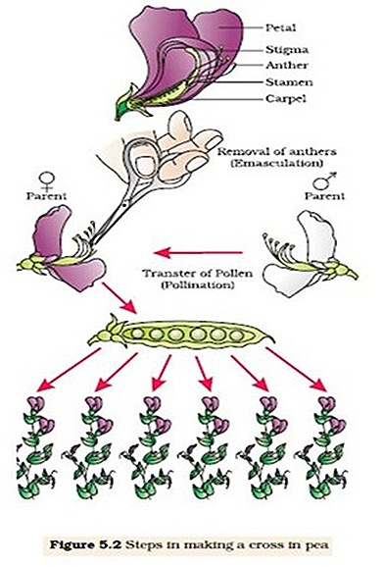

Slide 50
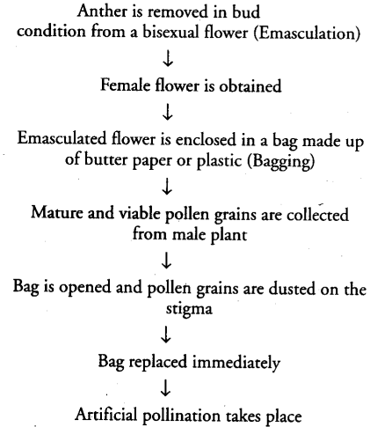

Slide 51
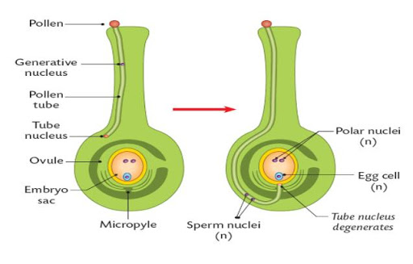

Slide 52
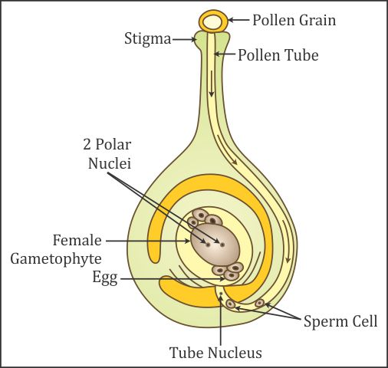

Slide 53
*
The pollen tube releases the two male gametes into the cytoplasm of the synergid.
Pollen tube into synergid
The pollen tube releases the two male gametes into the cytoplasm of the synergid.
Diploid Zygote formation - zygote develops into an embryo.
Syngamy
Other male gamete moves towards the two polar nuclei located in the central cell and fuses with them to produce a triploid PEN This central cell forms
Primary endosperm cell (PEC) and develops into the endosperm
Triple fusion
3 haploiad nucleus fuse

Slide 54
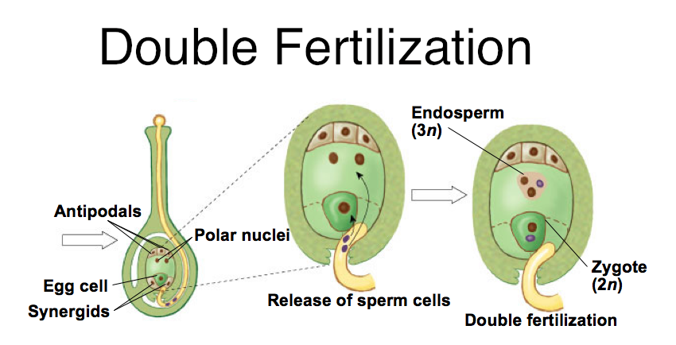

Slide 55
*
*After double fertilization events of endosperm and embryo development, maturation of ovule(s) into seed(s) and ovary into fruit, are collectively termed post-fertilisation events.
Endosperm development
Embryogeny
Seed formation
*Endosperm development : Primary Endosperm Cell (Triple fusion) – Endosperm (3n)
*Endosperm – cells filled with reserved food material -main
source of nutrition for the embryo.
31

Slide 56
*
The endosperm nucleus (3N) divides repeatedly to form the endosperm in endospermic seeds. This endosperm acts as a food store for the developing seed
e.g. maize
3N
endosperm
nucleus
2N Zygote

Slide 57
*
-
Nuclear
PEN successive nuclear divisions free nuclei. free- nuclear endosperm. Nuclei free, the cw formation afterwards.
Cellular
First and susequent divisions followed by cw
formation
Helobial
In between above two
Transvrse wall mucropylar and chalazal
chamber
Non persistant embryo in some seeds,& perisperm till germination

Slide 58
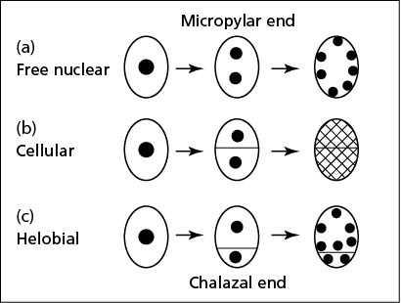

Slide 59
Embryogeny - Embryo formation – similar in Monocot and dicot Embryo develops micropylar end where the zygote is situated.
First endosperm develops then zygote. Provision of nutrition taken care.
 | Zygote – proembryo – globular mature heart shaped embryo
1 st division | Transverse division – 2 cells Cell twds micropyle embryo/terminal cell Other – basal cell / suspensor cell
Suspe nsor cell | Transverse division, 6-10 cells forms suspensor Terminal cell is swollen, vesicular Haustorium Lowermost – hypophysis to root tip and root cap

Slide 60
Dicot embryo consists of an embryonal axis and two cotyledons.
The portion of embryonal axis above the level of cotyledons is the epicotyl, which terminates with the plumule or stem tip.
The cylindrical portion below the level of cotyledons is hypocotyl that terminates at its lower end in the radical or root tip.
The root tip is covered with a root cap.
*

Slide 61
*In the grass family the cotyledon is
called scutellum - situated towards one side (lateral) of the embryonal axis.
* At its lower end, the embryonal axis has the radical and root cap enclosed in an undifferentiated sheath called coleorrhiza.
*The portion of the embryonal axis above the level of attachment of scutellum is the epicotyl. Epicotyl has a shoot apex and a few leaf primordia enclosed in a hollow foliar structure, the coleoptile.
*
37

Slide 62
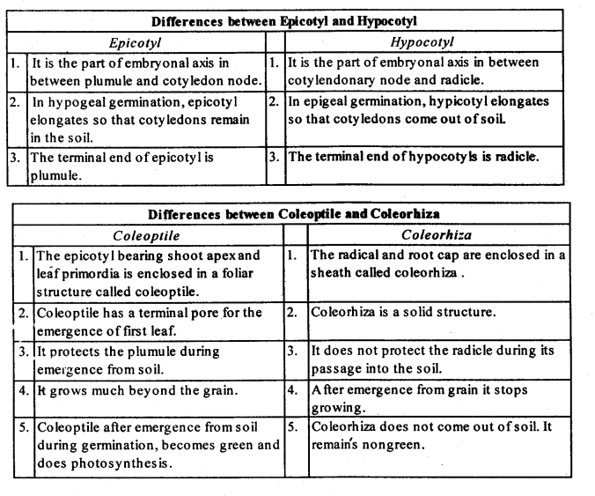

Slide 63
*
Endosperm Food store for developing embryo
Embryo Plumule, radicle, cotyledons
Micropyle – pore-entry Of oxygen, water during germination
Integuments, becomes the seed coat

Slide 64
*
If all the endosperm is absorbed by the developing embryo the seed is a non endospermic seed e.g. broad bean, pea, groundnut

Slide 65
*
If all the endosperm is not absorbed by the developing embryo the seed is an endospermic seed e.g.
Maize, wheat, barley, castor, sunflower

Slide 66
Non–endospermic and Endospermic seed
Endosperm
Cotyledon
Plumule
Radicle
e.g. Broad Bean
e.g. Maize

Slide 67
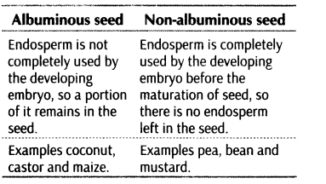

Slide 68
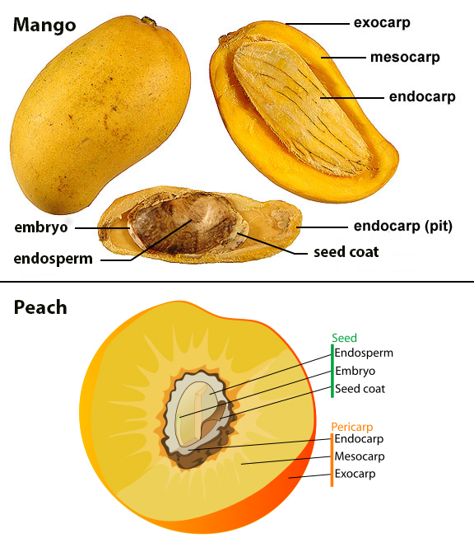

Slide 69
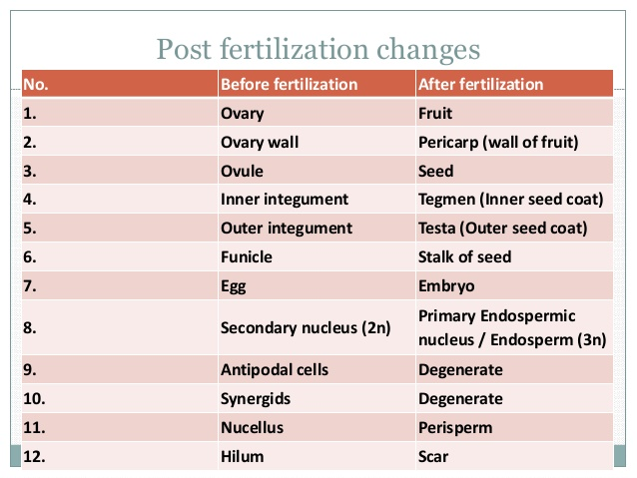

Slide 70
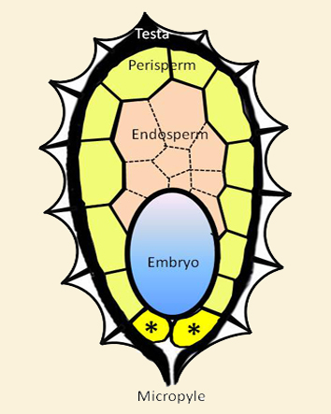

Slide 71
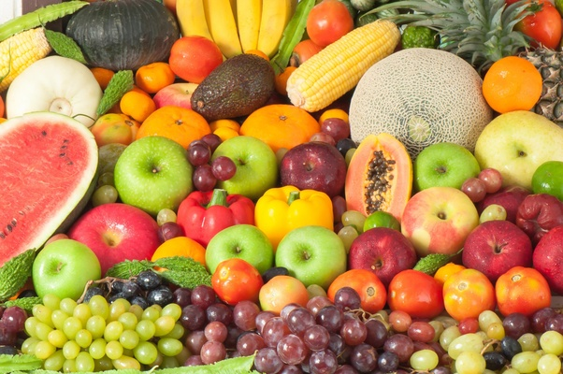

Slide 74
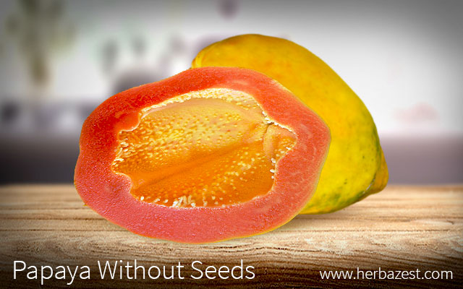
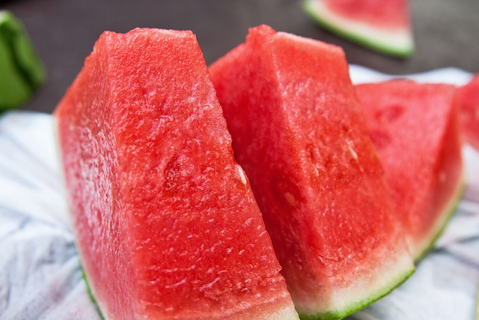
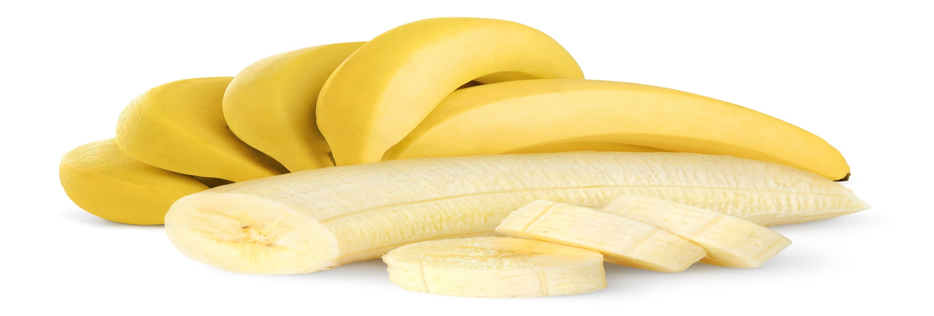

Slide 76
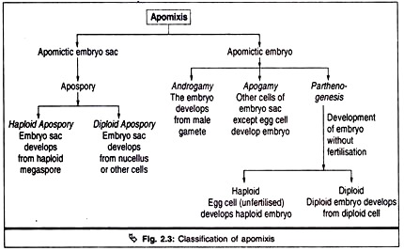

Slide 77
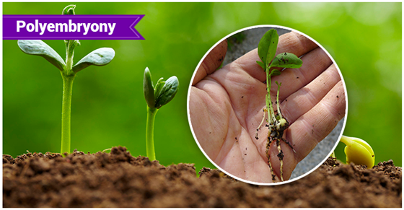
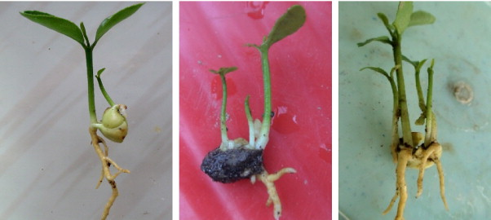

Slide 79
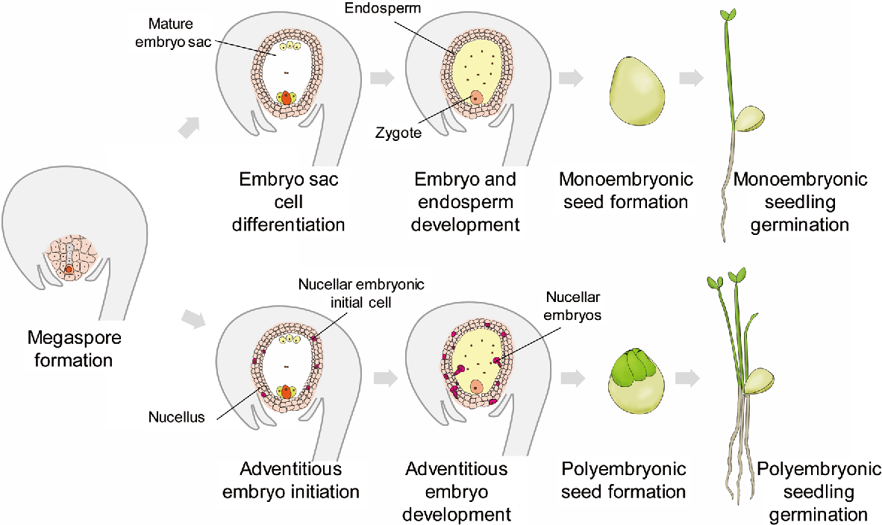

Slide 82
*
pollen is transferred
After fertilization
flower withers
2
3
1
seeds disperse and germinate into new plant
seeds develop in ovary
4
4

Slide 83
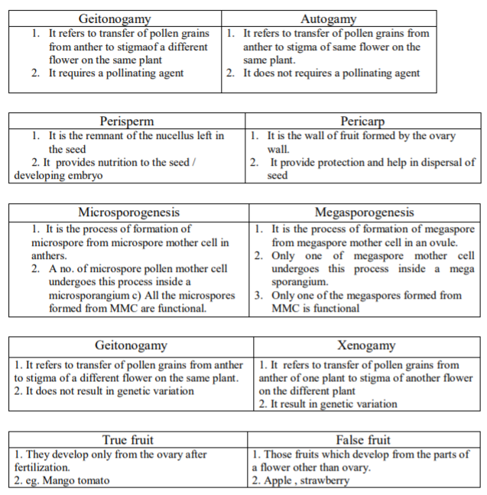

Slide 84
END OF CHAPTER
THANK YOU !

